Slide 1
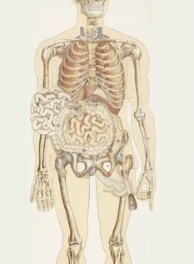
Cells and tissues
AEHBY ATAR Human Biology

Slide 2
Introduction
Course outline and assessment outline
Study requirements
Expectations

Slide 3
Study skills
Pre-reading
Glossary
Concept maps
Exam style questions

Slide 4
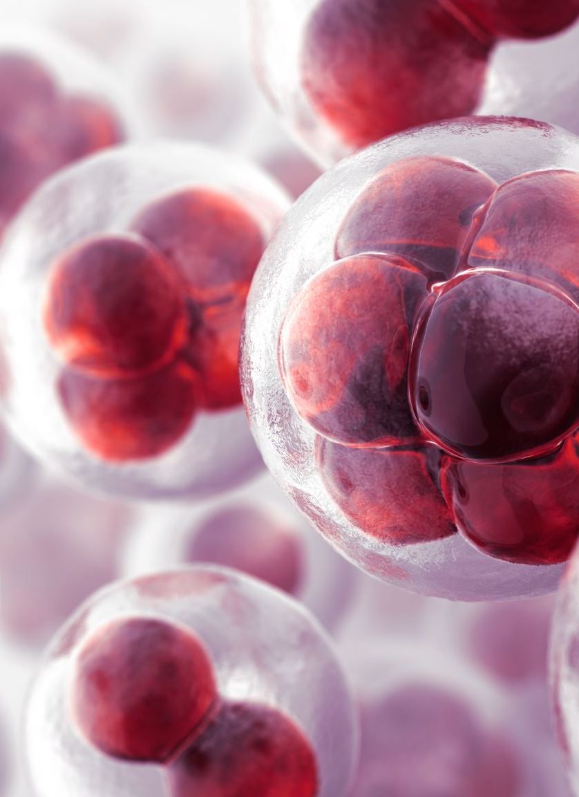
Learning Intentions
The human body is comprised of cells, tissues and organs within complex systems that work together to maintain life

Slide 5
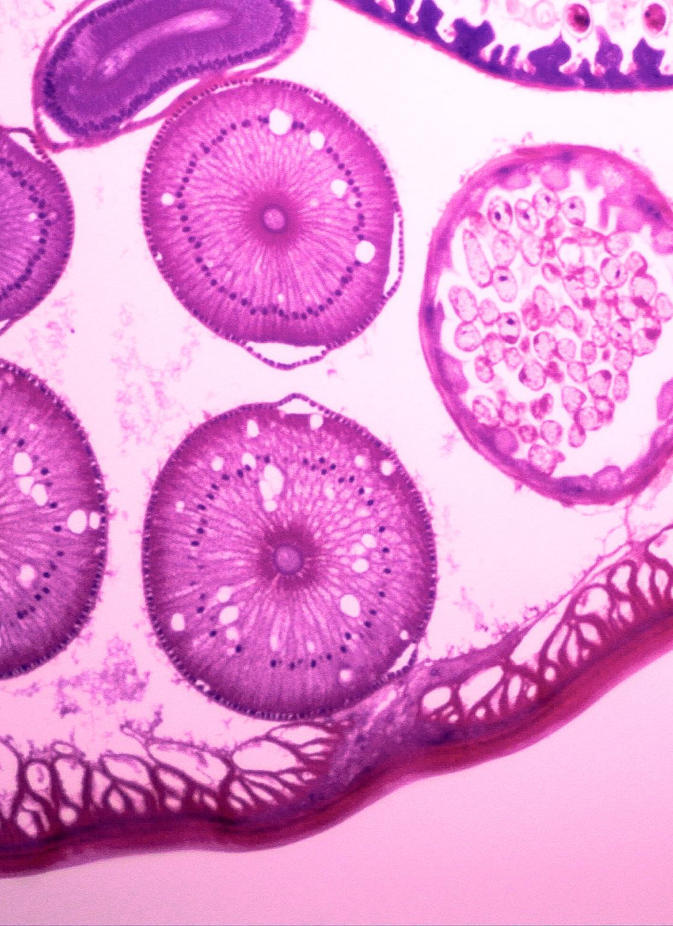
Success Criteria
Define cell, tissue, organ and system
Name or describe main cell parts
Identify major systems
Explain that cell structure relates to function, give examples.

Slide 6
Structural organisation of the body
Cells – Specialised to carry out particular functions
Tissues – Groups of similar cells with similar specialisation
Organs – Different tissues working together
System – Different organs working together for a common purpose.

Slide 7
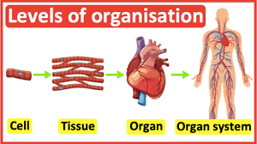

Slide 8
Cells
Smallest structure that can perform life functions.
Cell Size and Scale (utah.edu)
All living things are made of or by cells, from pre-existing cells.

Slide 9
Cell structure
Cell membrane | The outer boundary of the cell
Cytoplasm | Those parts within the cell membrane, except the nucleus
 | Includes jelly-like fluid and the organelles suspended in it
Organelles | Structures suspended in the cytoplasm that carry out particular functions
Cytosol | The liquid part of the cytoplasm
Cytoskeleton | Internal scaffolding of protein fibres within the cytoplasm
Inclusions | Chemical substances occurring as granules or liquid droplets in the cytoplasm

Slide 10
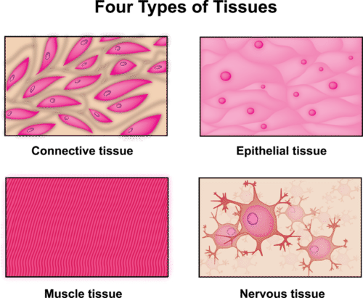
Tissues

Slide 11
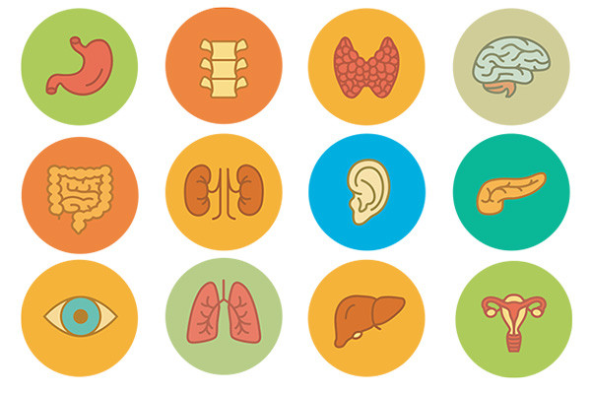
Organs

Slide 12
Systems
Digestive | Ingestion, breakdown and absorption of food
Respiratory | Intake of oxygen and removal of carbon dioxide
Circulatory | Transport of nutrients, oxygen and wastes to and from cells
Excretory | Removal of wastes
Nervous | Detection of changes in the environment and coordination of many body functions
Endocrine | Regulation and coordination of many body functions
Skeletal | Support and protection
Muscular | Movement and support
Immune | Protection against infection by microorganisms
Reproductive | Production of new individuals

Slide 13
Review
State the cell theory.
List from simplest to most complex: system, tissue, cell, organ.
What contains similar cells with similar specialisation?
What contains different tissues working together?
Using the skeletal system as an example, give an example from each level of organisation.

Slide 14
Success Criteria
Define cell, tissue, organ and system
Identify major systems
Explain that cell structure relates to function.

